Slide 1

Meet ChatDB
Your personal database translator and query companion

Slide 2

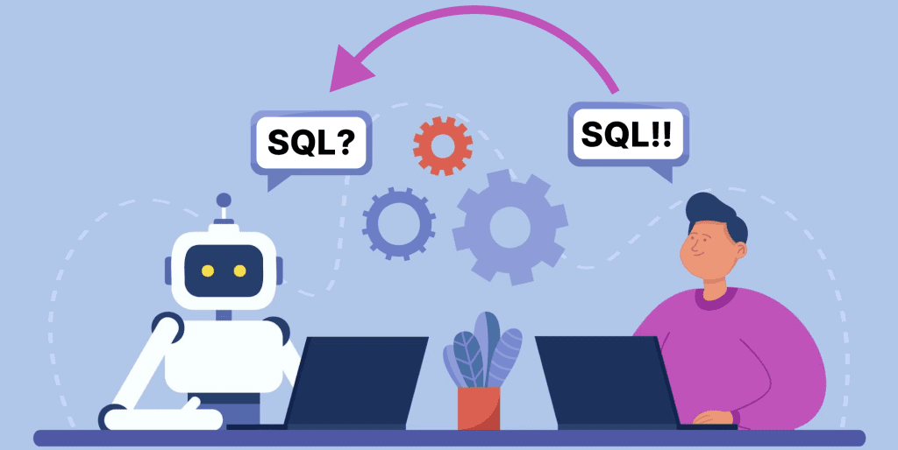



ChatDB's Superpowers
"Database X-Ray Vision" (Explore databases)
"Query Generation Beam" (Sample query generation)
"Language Transmutation" (Natural language to SQL)
"Data Summoning" (Query execution)
"Dataset Teleportation" (Data upload)

Slide 3
From Novice to SQL Pro
Step 1
Database Selection and Exploration
Users can create new databases or switch between existing ones
Explore table structures and sample data
Step 2
Sample Query Generation
ChatDB generates diverse queries using templates
Covers various SQL constructs (e.g., GROUP BY, HAVING, JOIN)
Step 3
Natural Language Interaction
Users can ask questions in plain English
ChatDB translates to SQL using pattern matching
Step 4
Query Execution and Analysis
Execute generated or custom queries
View and interpret query results
Notes:
Create a game-like progression chart showing how users advance their database skills with ChatDB's help

Slide 4


ChatDB's Brain
Three diverse datasets:
COVID-19 data for US states and counties
Coffee shop sales
Academic data (courses, students, instructors)
Keyword Trigger Mechanism:
ChatDB listens for specific keywords in user queries to determine the appropriate action, ensuring responsive interaction. E.g., "generate sample queries" triggers query generation function

Slide 5

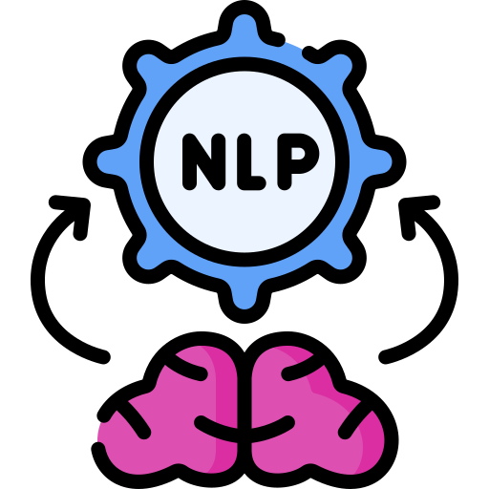
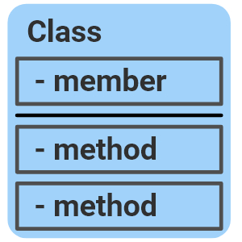

Query generation process:
Query template generation
Template population with appropriate column and table names
Construct-specific filtering for targeted queries
Natural language processing:
Regex pattern matching for query interpretation
Converts user questions to SQL queries
ChatDB Class Structure:
The ChatDB class is instantiated for each database session, managing connections and executing queries seamlessly.
Python-Powered Execution:
ChatDB is built entirely in Python, leveraging its capabilities for efficient database interaction and data manipulation.

Slide 6

ChatDB's Evolution
Web-based user interface
Support for NoSQL databases
Advanced NLP using machine learning
Query optimization suggestions

Slide 7
Conclusion
Simplifies database interaction for learners
Bridges the gap between natural language and SQL
Provides a foundation for more advanced database skills

